Slide 1
Lecture 22
Nick Rugai PhD

Slide 2
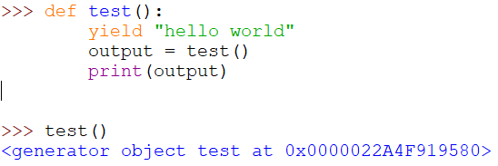
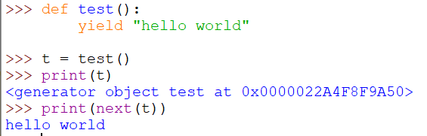
Generators
This function is not able to print!

Slide 3
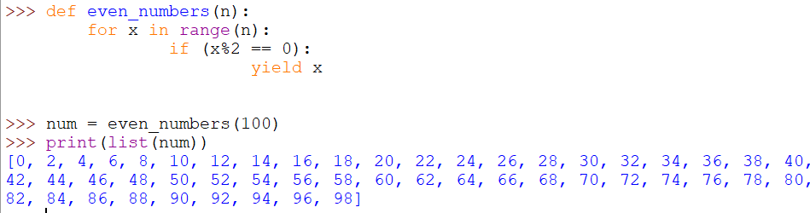
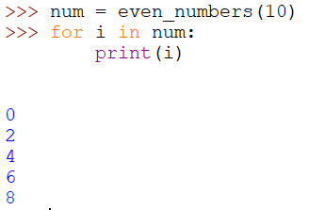
Generators
Using list to print all results

Slide 4
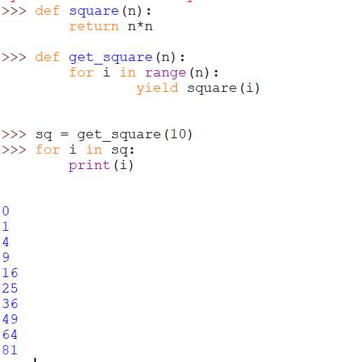
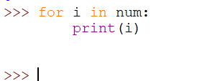
Generators
What happened to num?
Generators are one time use only!!!

Slide 5
Generators
Use yield vs. return when the date is large.
Use yield to save on memory.
Use yield if you need to return a large data set.
Use yield to generate large or infinite data sets.

Slide 6
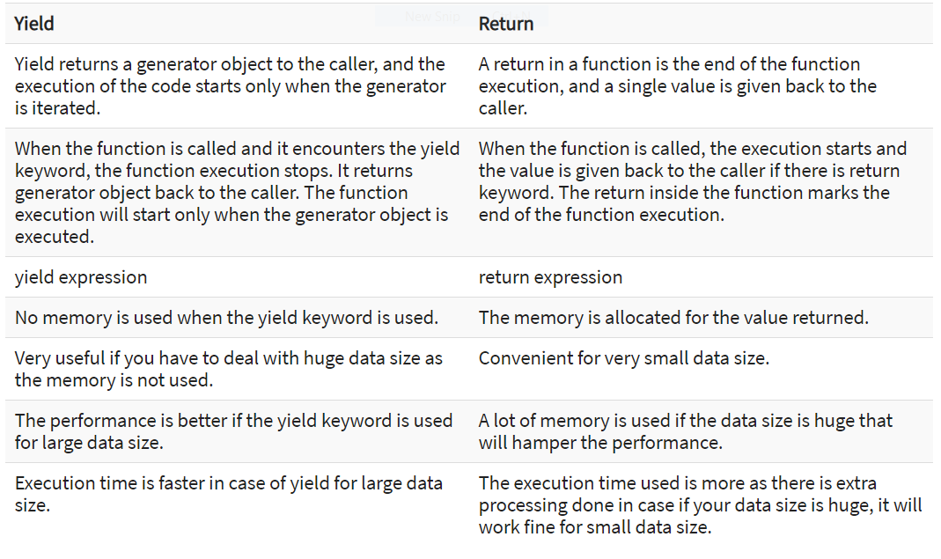
Generators

Slide 7
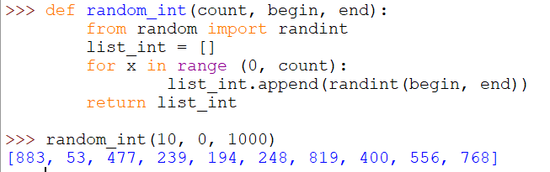
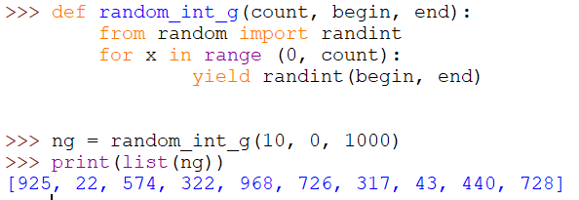
Generators

Slide 8
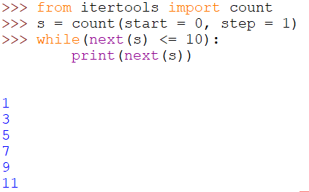
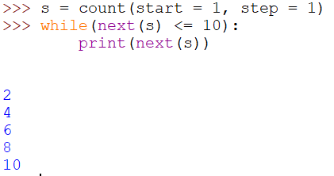
itertools
Using count to print even and odd numbers

Slide 9
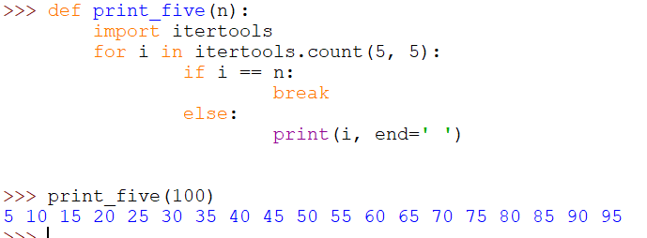
itertools
Using count to print multiple of 5

Slide 10
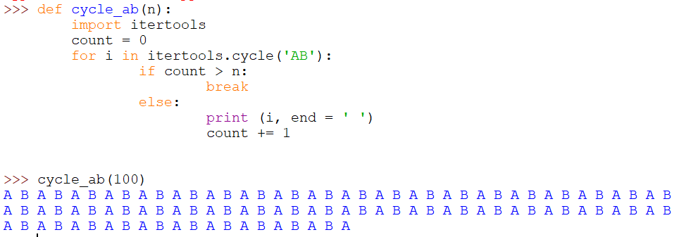
itertools
Using cycle and count to print multiple of an alternating sequence

Slide 11
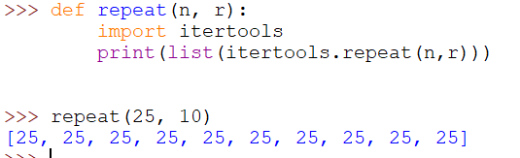
itertools
Using repeat to print a repeating number

Slide 12
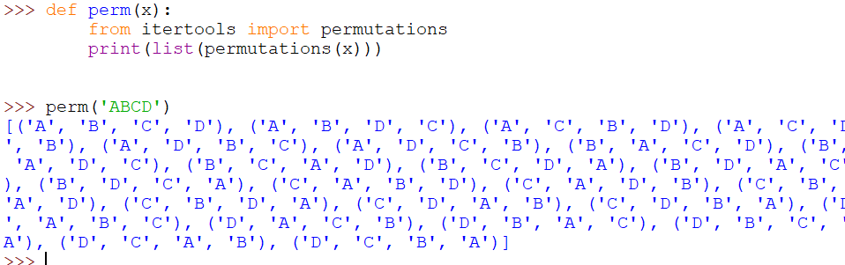
itertools
Using permutations

